Slide 1


Sarajevo Summer School in Next-Generation Air Quality, 7 – 8 September 2026
From aerosol chemistry to environmental policy:
Introduction to receptor modeling
for PM source apportionment
Evangelia (Lila) Diapouli
National Centre for Scientific Research “Demokritos”
ldiapouli@ipta.demokritos.gr

Slide 2
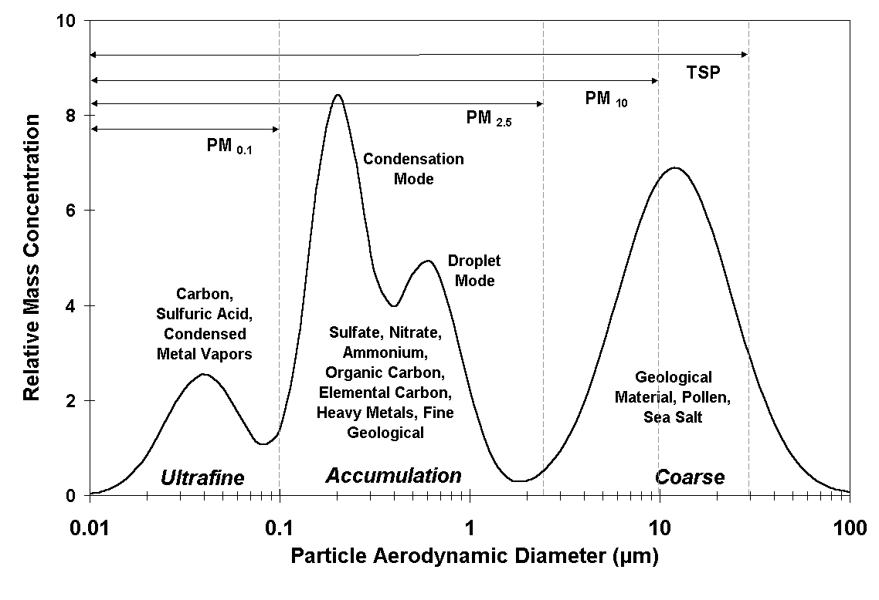
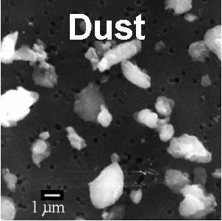
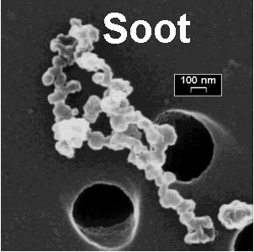
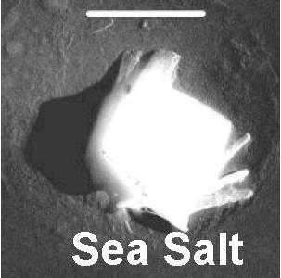
Why do we need aerosol source apportionment?
Sarajevo Summer School in Next-Generation Air Quality, 7 – 8 September 2026
1/17

Slide 3

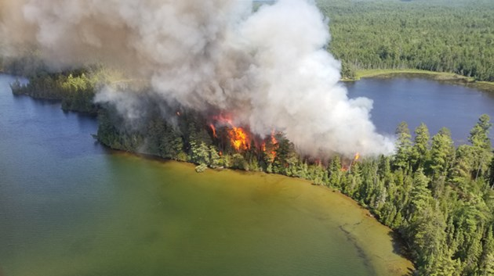



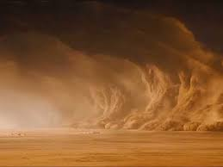




Why do we need aerosol source apportionment?
Anthropogenic and natural sources define the PM levels and its chemical composition
Sarajevo Summer School in Next-Generation Air Quality, 7 – 8 September 2026
2/17

Slide 4
Why do we need aerosol source apportionment?
Reliable and quantitative information on pollution sources is essential for policy makers to
    implement targeted environmental policies
    identify the cause of exceedances (related to natural or anthropogenic sources) and develop mitigation measures
    quantify transboundary pollution
    inform the public.
Sarajevo Summer School in Next-Generation Air Quality, 7 – 8 September 2026
3/17

Slide 5
How can we apportion PM to its sources?
Sarajevo Summer School in Next-Generation Air Quality, 7 – 8 September 2026
4/17

Slide 6
Why do we need aerosol source apportionment?
Sarajevo Summer School in Next-Generation Air Quality, 7 – 8 September 2026
4/17

Slide 7
Why do we need aerosol source apportionment?
Sarajevo Summer School in Next-Generation Air Quality, 7 – 8 September 2026
4/17

Slide 8


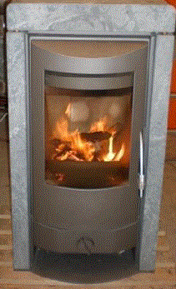
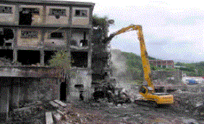

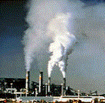

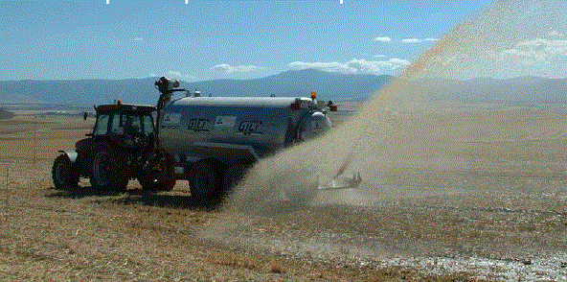


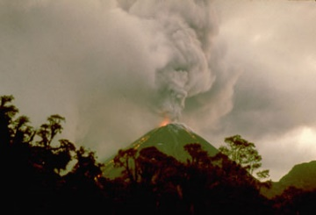
How does aerosol chemistry lead us to its sources?
Mineral components
Elemental & Organic carbon
Marine aerosol
Trace elements
Secondary Inorganic species (SO₄²⁻, NO₃⁻, NH₄⁺)
Sarajevo Summer School in Next-Generation Air Quality, 7 – 8 September 2026
5/17

Slide 9
Receptor models
The fundamental principle of receptor modelling is that mass conservation between the emission source and the study site can be assumed, and a mass balance analysis can be used to identify and apportion sources of atmospheric pollutants.
Contribution to PM (μg/m³) of a source (k) in time i
OC (μg/m³) measured in time i
Relative mass of OC in the chemical profile of a source (k)
Sarajevo Summer School in Next-Generation Air Quality, 7 – 8 September 2026
6/17

Slide 10
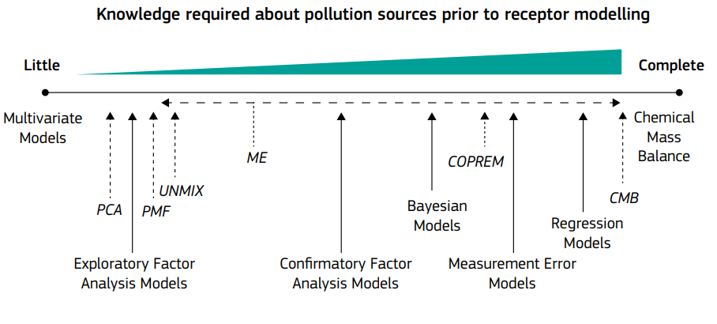
Receptor models
Viana et al., 2008
Sarajevo Summer School in Next-Generation Air Quality, 7 – 8 September 2026
7/17

Slide 11
Basic assumptions
Source profiles do not change significantly over time
No significant changes in data collection/analysis methodology have occurred
Data are representative of the area and its typical sources
Sources have sufficient variability in time and space
If source profiles are provided as input, it is important to have good knowledge of the type of sources and to use representative for the study area source profiles.
Sarajevo Summer School in Next-Generation Air Quality, 7 – 8 September 2026
8/17

Slide 12

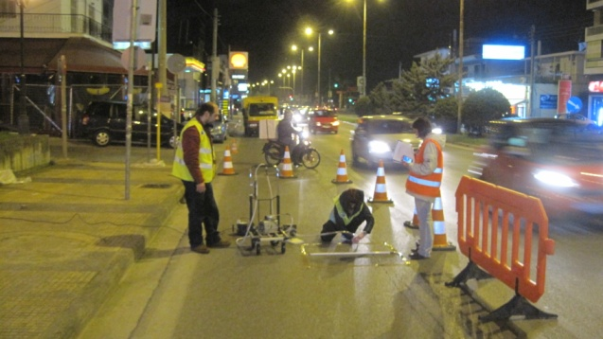
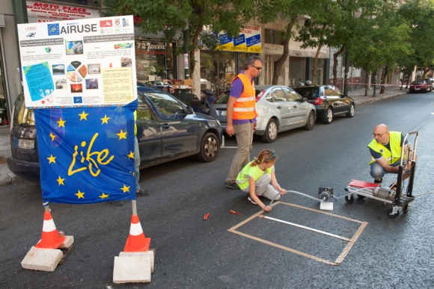
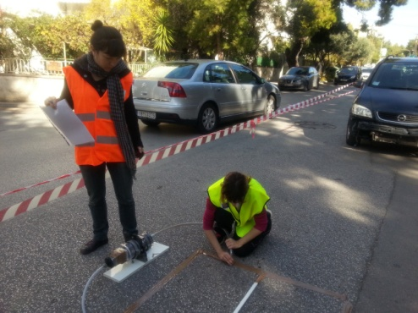
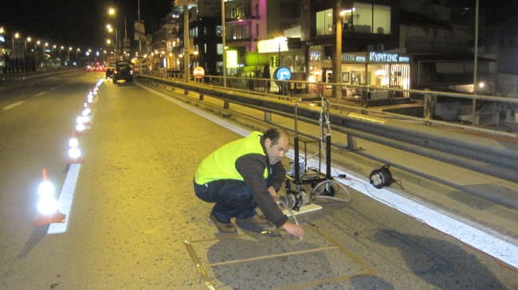
Characterization of road dust chemical profile
Road dust sampling campaign in Athens (Greece)
Sarajevo Summer School in Next-Generation Air Quality, 7 – 8 September 2026
9/17

Slide 13
What do we need to apply receptor modelling?
Comprehensive characterization of aerosol chemical composition
    Cover the majority of PM mass
    Include key source tracers
Large time series (to cover different conditions and provide the model with enough data)
At least some knowledge of major sources in the area
Ancillary data (emission inventories, meteorological data)
Mineral components
Elemental & Organic carbon
Marine aerosol
Trace elements
Secondary Inorganic species (SO₄²⁻, NO₃⁻, NH₄⁺)
Sarajevo Summer School in Next-Generation Air Quality, 7 – 8 September 2026
10/17

Slide 14
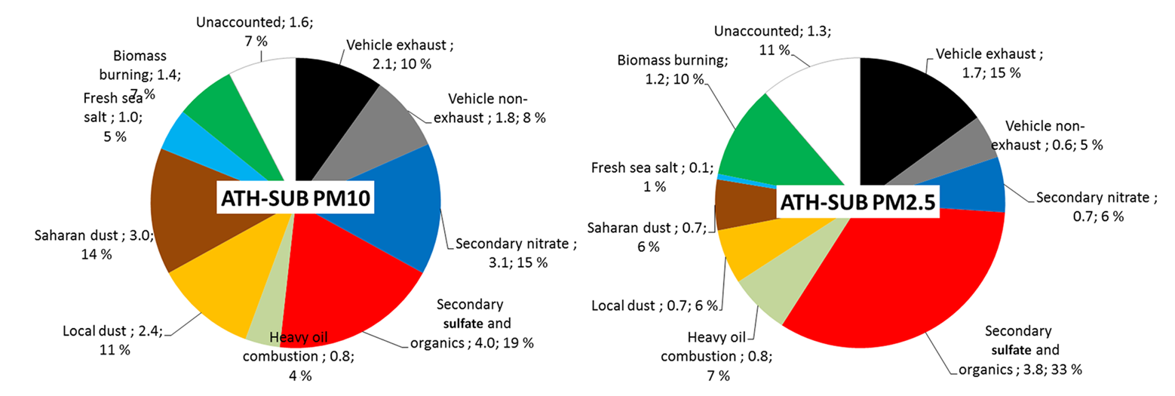
How does SA support policy making?
Amato et al., Atmos. Chem. Phys., 16, 3289–3309, 2016
Sarajevo Summer School in Next-Generation Air Quality, 7 – 8 September 2026
11/17

Slide 15
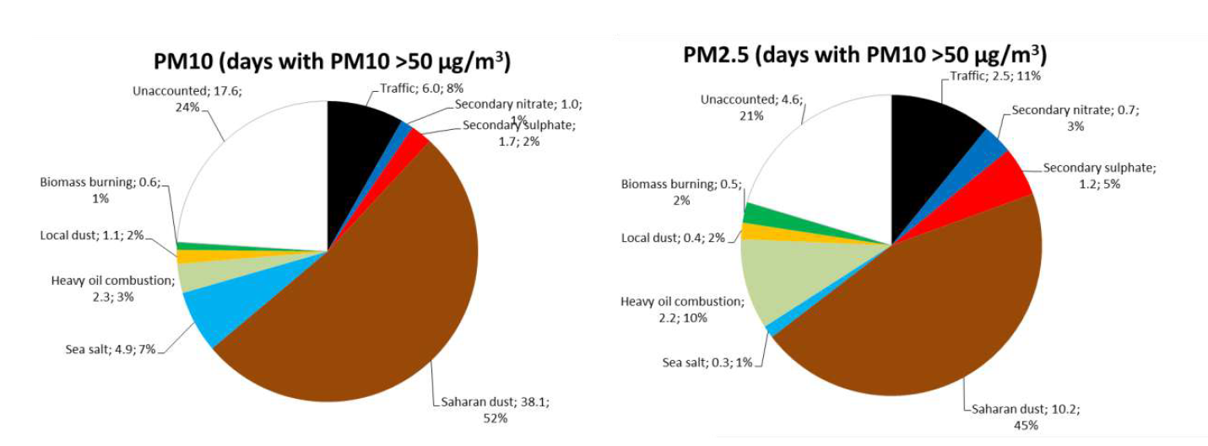
How does SA support policy making?
Sarajevo Summer School in Next-Generation Air Quality, 7 – 8 September 2026
12/17

Slide 16
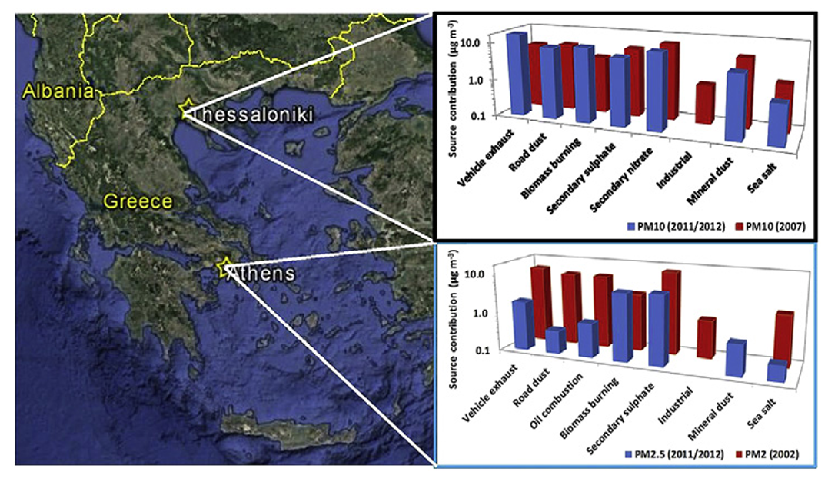
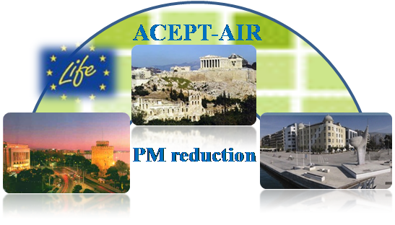
How does SA support policy making?
Diapouli et al., Atmospheric Environment 164, 416-430, 2017
Sarajevo Summer School in Next-Generation Air Quality, 7 – 8 September 2026
13/17

Slide 17
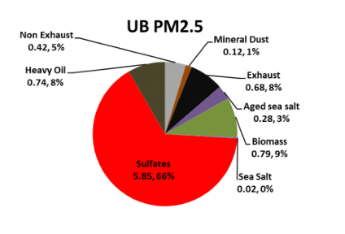
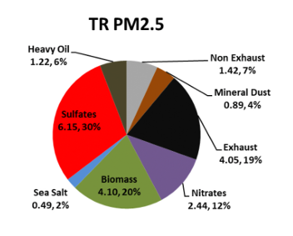
How does SA support policy making?
Athens urban background
Athens urban traffic
Manousakas et al., Environmental Research 192, 110257, 2021
Sarajevo Summer School in Next-Generation Air Quality, 7 – 8 September 2026
14/17

Slide 18
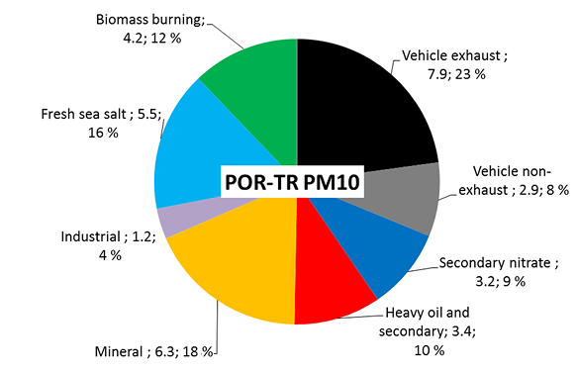
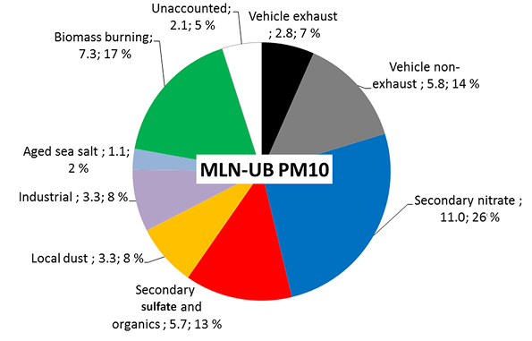
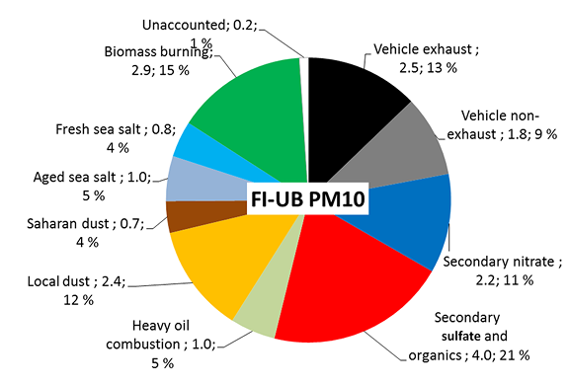
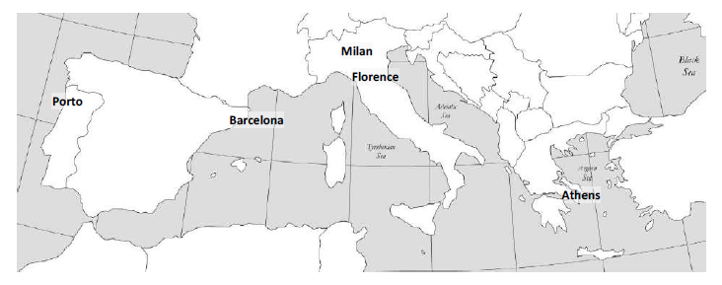
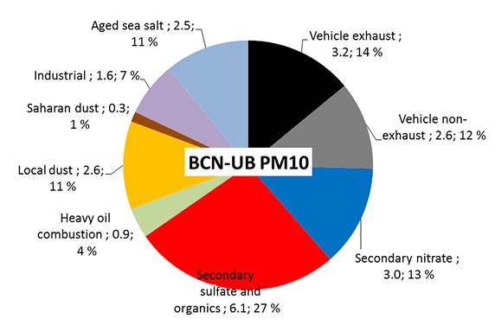
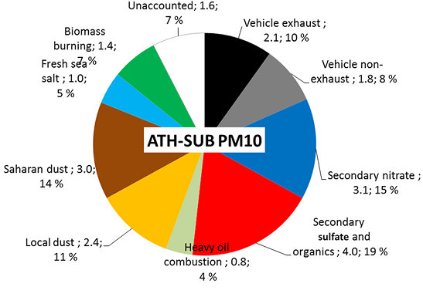
How do source contributions vary across countries?
Amato et al., Atmos. Chem. Phys., 16, 3289–3309, 2016
Sarajevo Summer School in Next-Generation Air Quality, 7 – 8 September 2026
15/17

Slide 19
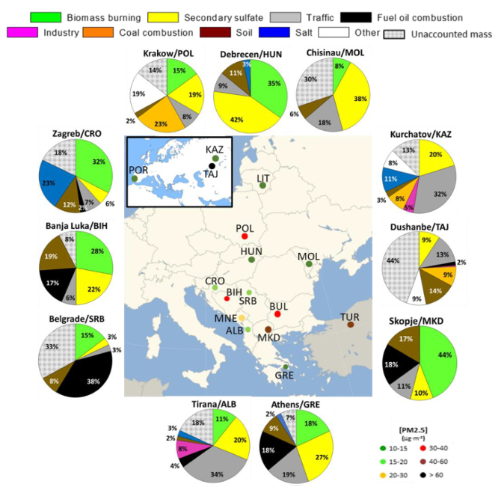
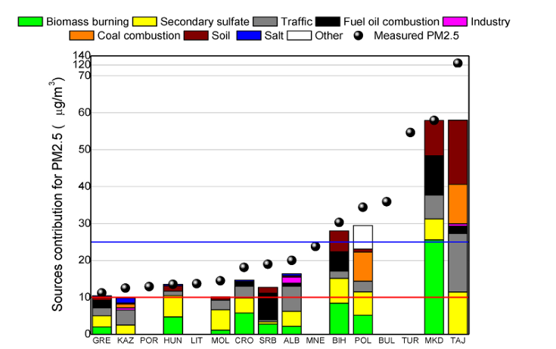
How do source contributions vary across countries?
Almeida et al., Environmental Pollution, 266, 115199, 2020
Sarajevo Summer School in Next-Generation Air Quality, 7 – 8 September 2026
16/17

Slide 20
If you are interested in experimenting with receptor modelling…
EPA PMF 5.0 is a free program to solve PMF, based on a user-friendly interface and offering a number of advanced tools (uncertainty estimates, application of additional constraints).
You can download the software from:
https://www.epa.gov/air-research/forms/registration-download-and-use-epa-pmf-50
Sarajevo Summer School in Next-Generation Air Quality, 7 – 8 September 2026
17/17

Slide 21


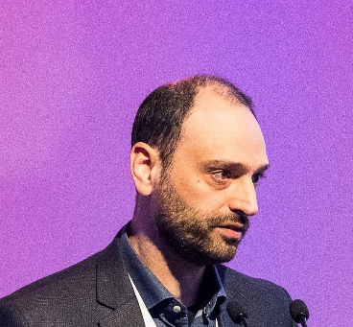
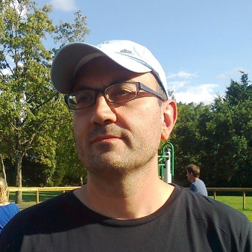

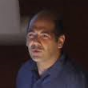
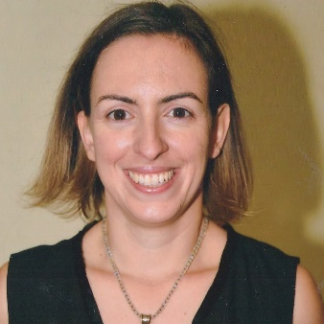
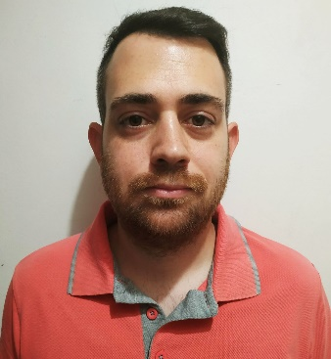
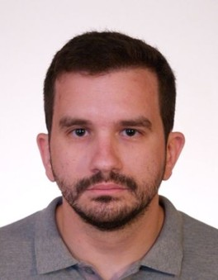




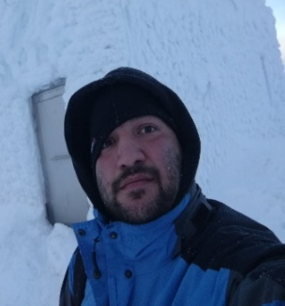
Thank you for your attention!
Kostas Eleftheriadis
Lila
Diapouli
Manos
Manousakas
Stergios
Vratolis
Maria
Gini
Prodromos Fetfatzis
Vasiliki Vasilatou
Kostas Granakis
Angelos Laoutaros
Lina Katsikari
Stella Diakoulaki
Electra
Lemi
Robert
Sultana
Panos
Karkavitsas
Sarajevo Summer School in Next-Generation Air Quality, 7 – 8 September 2026

